Slide 1

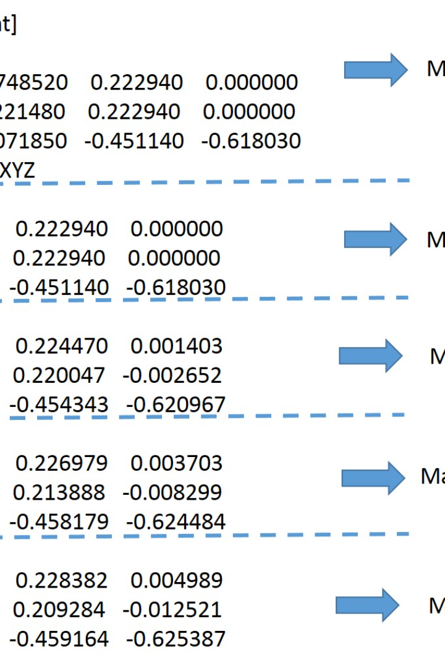


Introduction to Text Processing in Linux
Welcome to the Introduction to Text Processing in Linux presentation! In this session, we will explore three powerful commands: awk, sed, and grep. These essential tools will equip you with the skills needed to efficiently manipulate and process text in the Linux environment.
by Shravani Potharaju

Slide 2

Agenda
Introduction to text processing tools
grep command
sed command
awk command
Practical examples

Slide 3


Introduction to Text Processing
Text processing plays a vital role in Linux, enabling efficient manipulation of textual data. With vast amounts of information that need analysis and modification, mastering the art of text processing is essential. In this section, we will explore why text processing is crucial in the Linux ecosystem and the value it brings to various tasks.

Slide 4
The grep Command
Syntax: grep [options] pattern [file...]
Description: Searches for a specified pattern in one or more files.
Examples:
grep "keyword" file.txt - Search for "keyword" in file.txt.
grep -i "pattern" file.txt - Conduct a case-insensitive search.
grep -r "pattern" /path/to/directory - Recursively search for "pattern" in a directory.

Slide 5
The sed Command
Syntax: sed [options] 'script' [file...]
Description: Stream editor for text manipulation and transformation.
Examples:
sed 's/old/new/' file.txt - Replace the first occurrence of "old" with "new" in file.txt.
sed '1,3d' file.txt - Delete lines 1 to 3.
sed -n '/pattern/p' file.txt - Print lines containing "pattern."

Slide 6
The awk Command (Part 1)
Syntax: awk 'pattern { action }' [file...]
Description: A versatile text processing tool for data extraction and reporting.
Examples:
awk '{ print $1 }' file.txt - Print the first field of each line.
awk '/pattern/ { print $2 }' file.txt - Extract the second field from lines containing "pattern."

Slide 7
The awk Command (Part 2)
Syntax: awk 'BEGIN { action }'
Description: Special BEGIN block for initialization.
Examples:
awk 'BEGIN { sum=0 } { sum+=$1 } END { print sum }' file.txt - Calculate the sum of the first column.

Slide 8

Conclusion
In conclusion, we have explored the fundamentals of text processing in Linux, focusing on three essential commands: grep, sed, and awk. Each command offers unique capabilities for efficient text manipulation and data extraction. By mastering these tools, you will have the necessary skills to tackle complex text processing tasks in the Linux ecosystem. Embrace the power of grep, sed, and awk, and embark on a journey of enhanced productivity and text processing excellence.

